Slide 1

Global markets
Parkavi Srinivasa’s
GDP ANALYSIS
&
INSIGHT REPORT
12%
45%
55%

Slide 2
AGENDA
INTRODUCTION
PROJECT- GOALS / TECH STACK
DATA QUESTIONS / INFLUENCERS OF GDP
DASHBOARDS - WALKTHROUGH
RESULTS
CHALLENGES
Global markets
Notes:
Let’s get started.

Slide 3
INTRODUCTION
GDP is the key player for each country, which explains the country’s growth.
GDP has emerged as a comprehensive scorecard of a nation’s robustness.

Slide 4




PROJECT - GOALS
Analyze the dataset
Identify the key indicators
Apply models
Derive insights and help international investors
DATA SOURCE:
Notes:
Analyze the dataset of top economies of the world and identify key economic indicators influencing GDP.
Apply models on the curated dataset to perform EDA.
Derive meaningful insights using Tableau and help international investors with their future investments.

Slide 5
Indicators Influencing GDP
Inflation Deflator (%)
Population Growth (%)
Tax Revenue
(% GDP)
GDP Growth
(Annual %)
Unemployment
(% total labor force)
Total Reserves
(% total external debt)
Trade (%GDP)
Notes:
The key indicators influencing GDP listed here are considered important in analyzing and answering data questions. And Foreign Direct Investments (FDI)

Slide 6
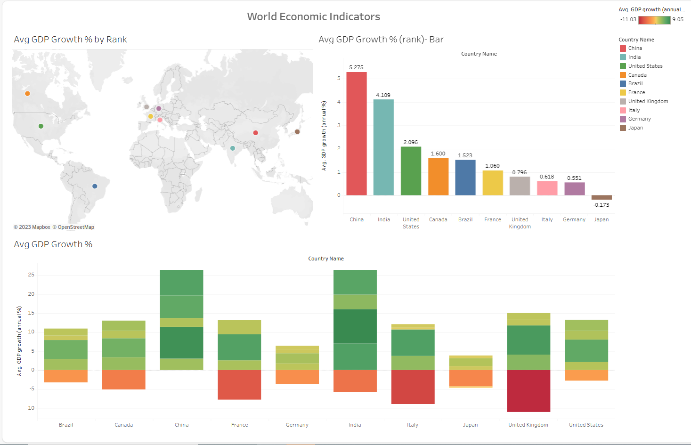
Notes:
EDA modeling was initially performed on around 25 major indicators for the top 10 countries for the last 25 years .
Based on those results, these visuals are narrowed down to the last 5 years and the top 5 countries and 7 indicators.
Based on GDP Growth (annual %) it is evident that China and India top 1 and 2 places in GDP Growth followed by USA, Canada, and Brazil

Slide 7
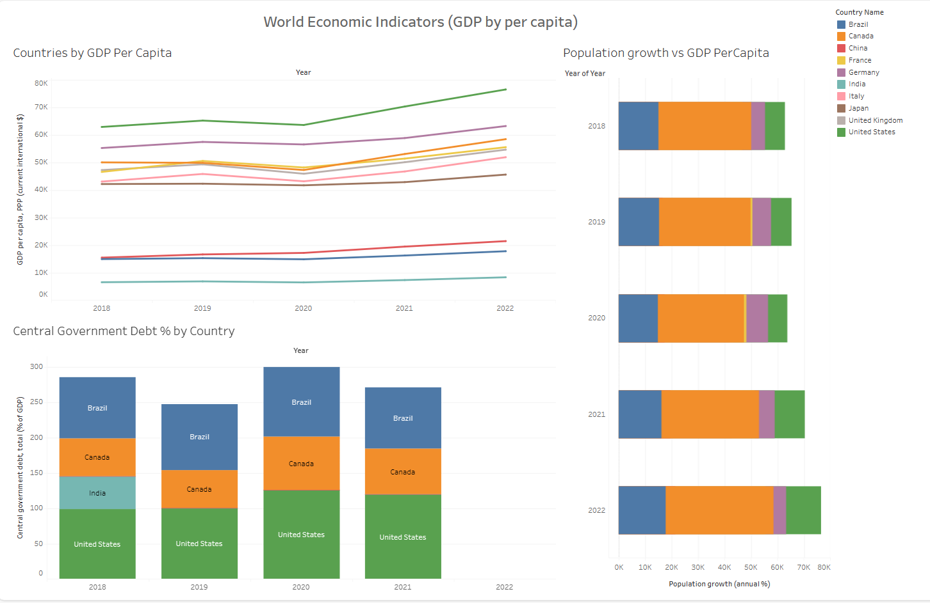
Notes:
Apart from GDP growth (annual %), these visuals are based on GDP per capita for the top 10 countries,
This makes evident, that population growth has a strong correlation with GDP per capita
Also, only a few countries out of the top 10 have Central government debt %

Slide 8
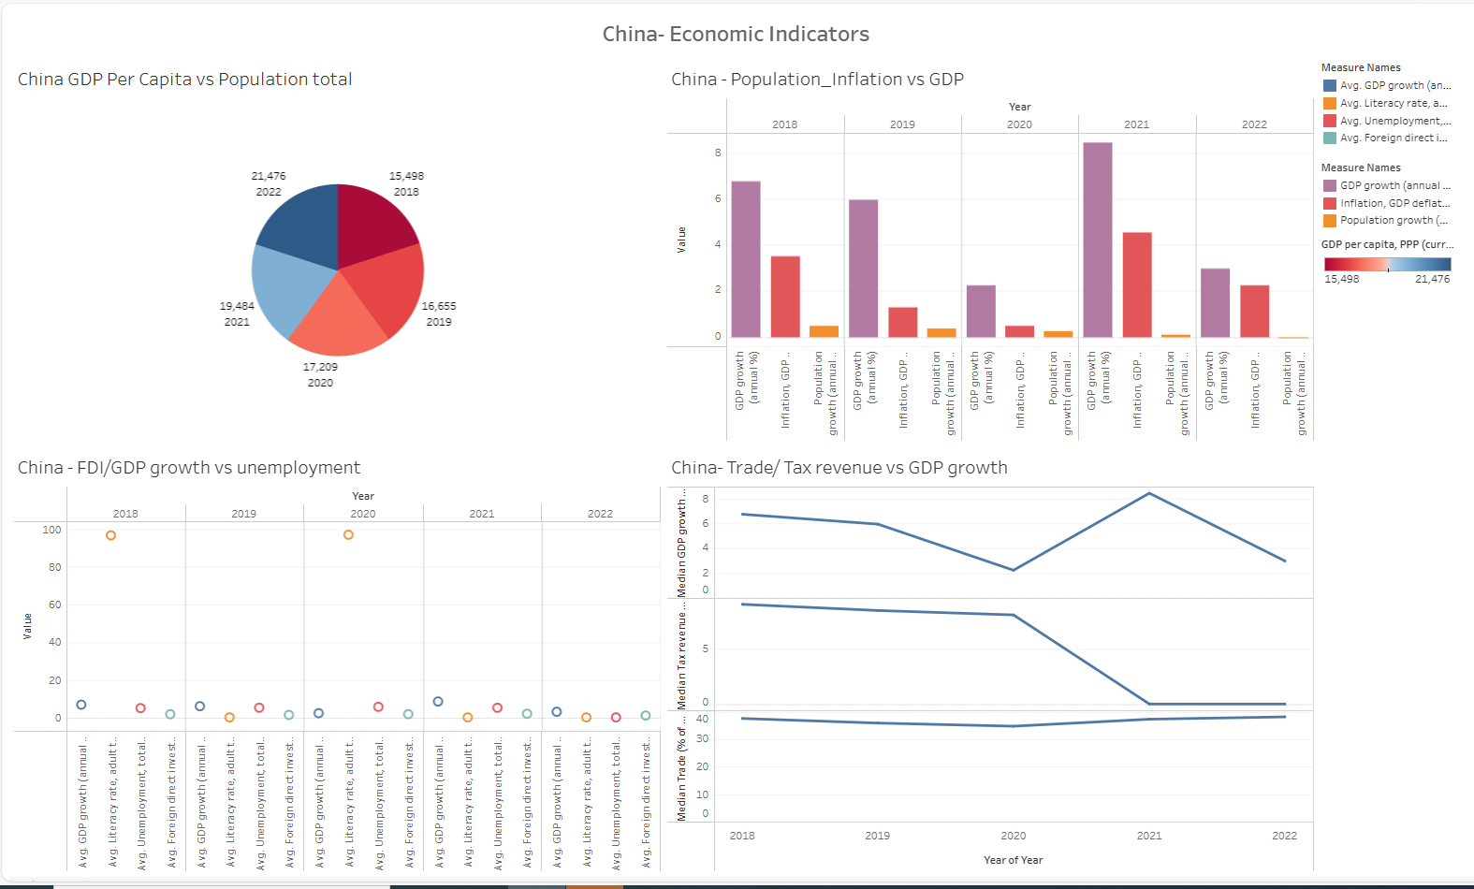
Notes:
Let’s take a deep dive into China’s Economic Indicator
GDP per capita increases or decreases inversely with Population
Combination of (Trade and Tax revenue), and (Inflation rate, inclusive of population) has a strong positive correlation with GDP growth (%)
FDI and Unemployment(%) also influence the GDP growth.

Slide 9
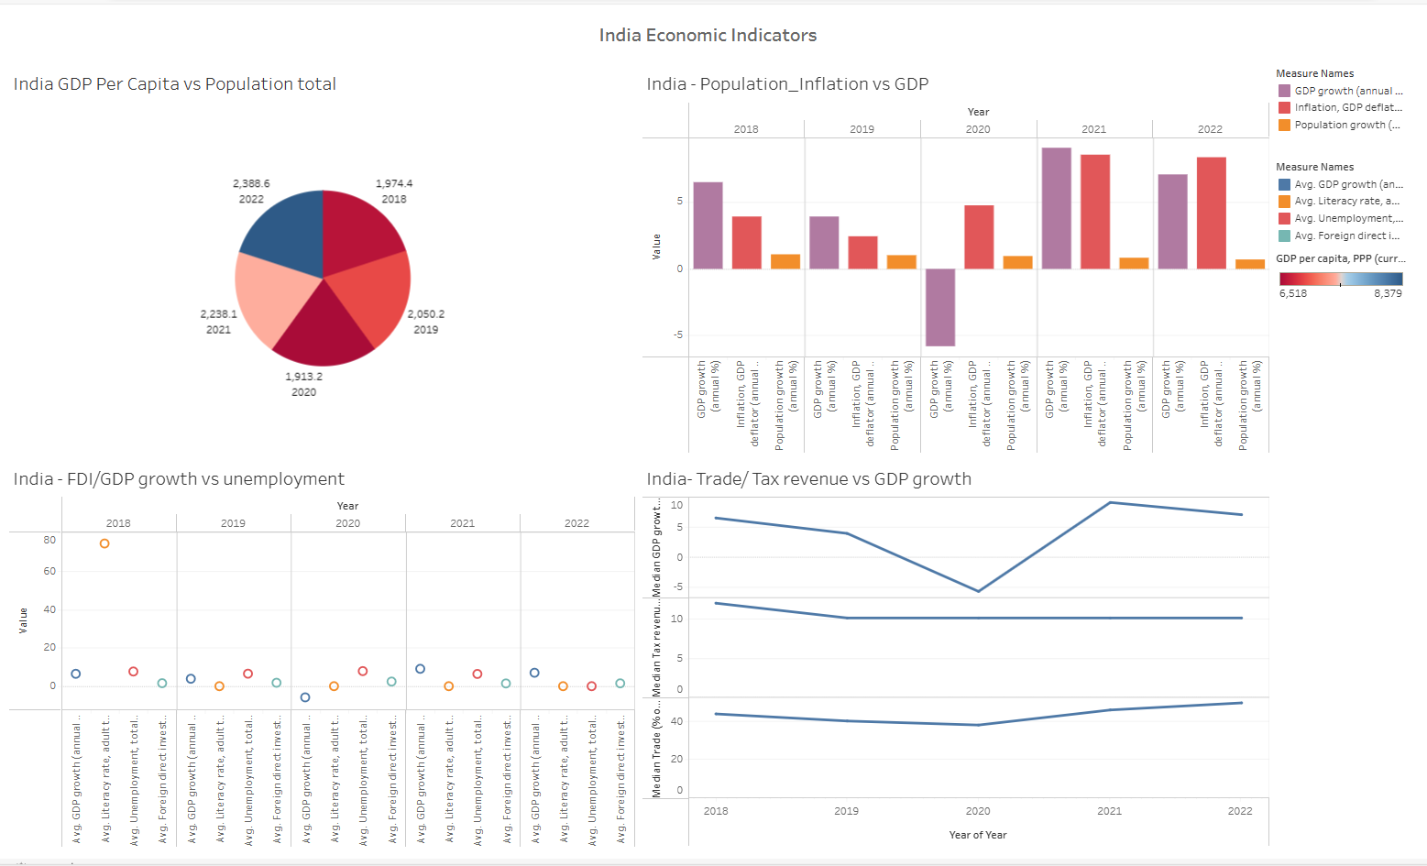
Notes:
The above graphs indicate that India also has factors that are influencing the GDP growth (%) [Population, Inflation, FDI, Trade and Tax revenues] similar to China.
Also, India has outranked China for the last 2 years and is the leading economy with the highest GDP growth annual % currently

Slide 10
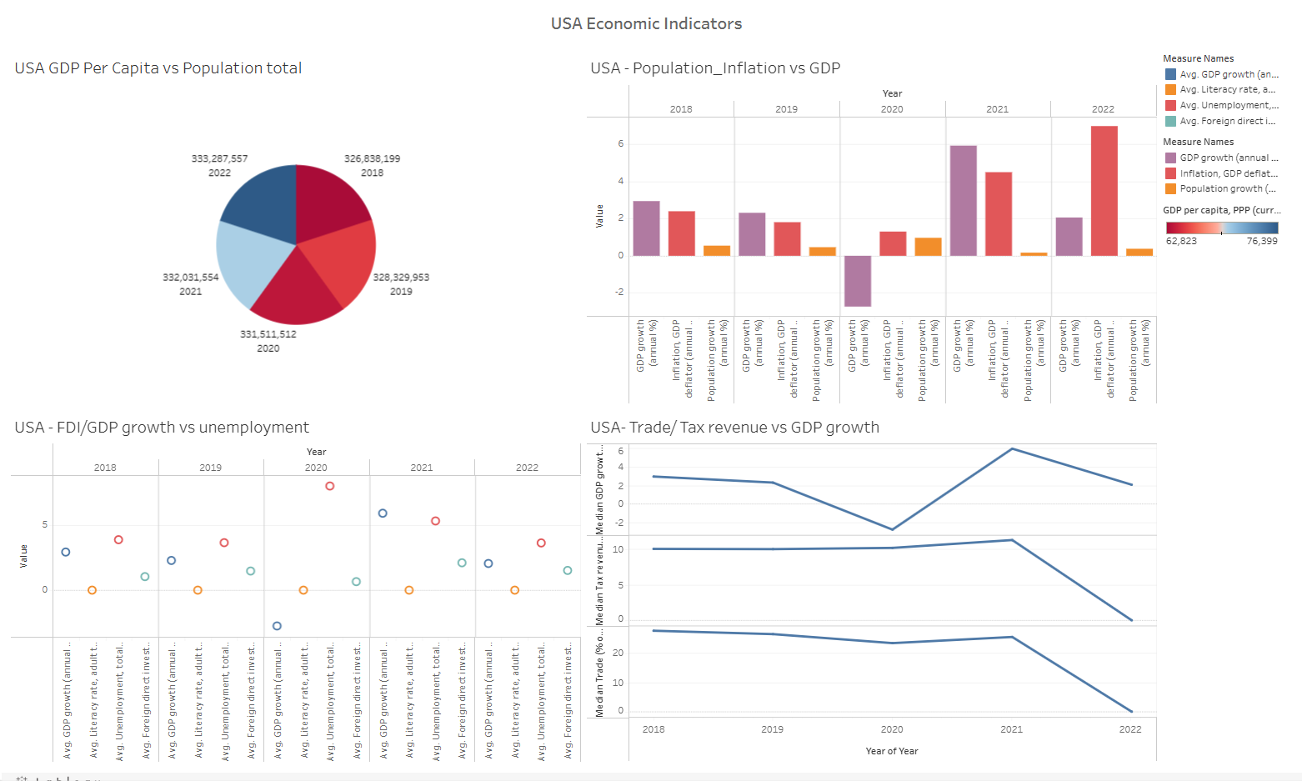
Notes:
For USA FDI and Unemployment % are the major key factors that influence the overall GDP growth (%), followed by (Trade and Tax revenue) and (population total and GDP per capita)
having strong correlation with GDP annual growth (%)

Slide 11
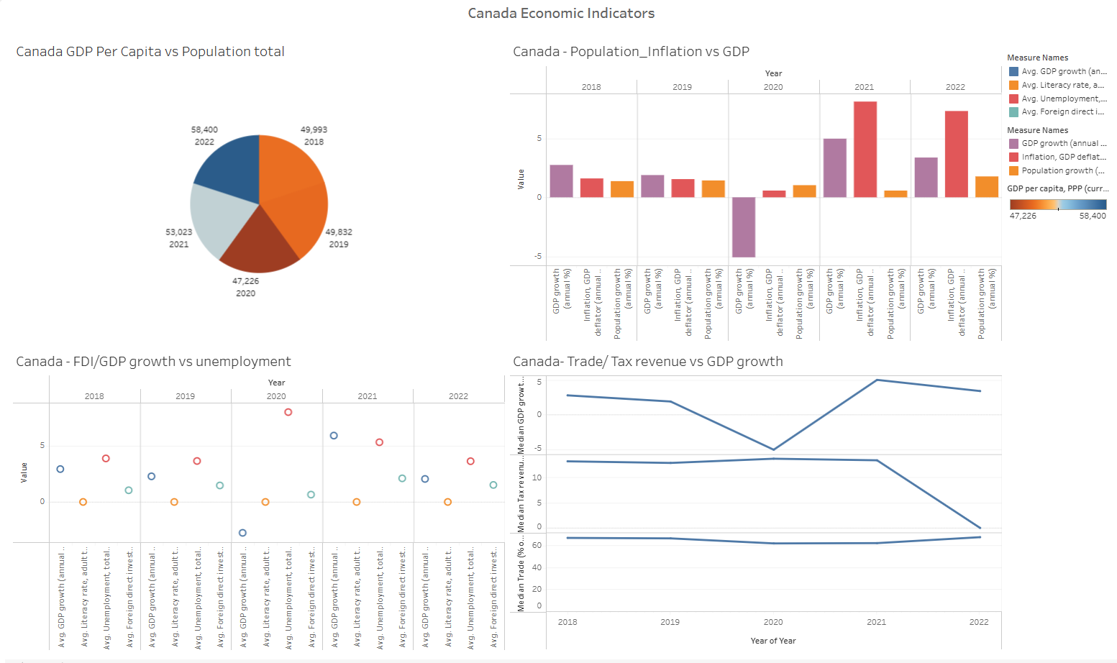
Notes:
Like USA, Canada also has FDI and Unemployment (%) as influential factors towards GDP growth(%)
There was a dip in the population for Canada in 2020. As a result of which, there was decrease in the GDP growth %

Slide 12
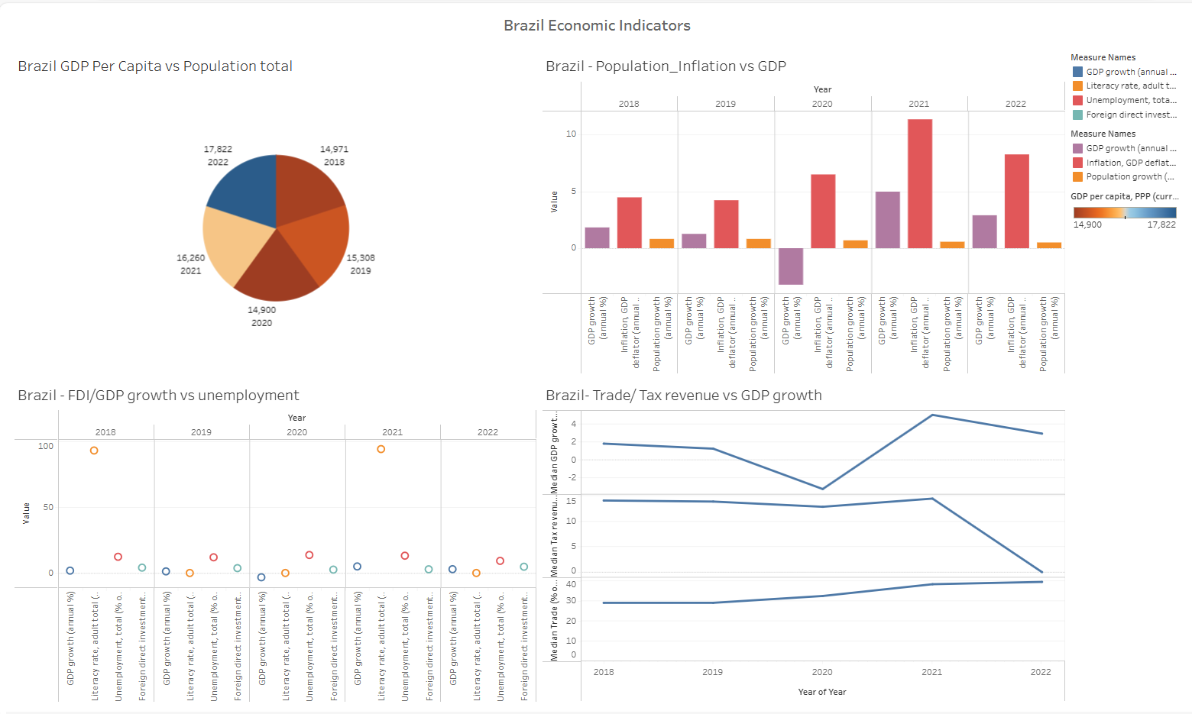
Notes:
FDI has a strong correlation with GDP Growth (%) for BRAZIL
Trade and Tax revenue has positive correlation with GDP %

Slide 13
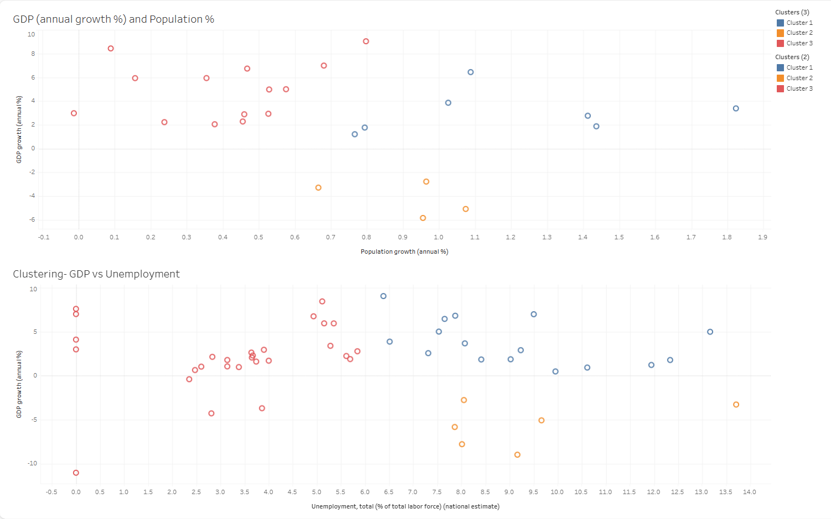
Notes:
Overall, we can see population and Unemployment have a strong correlation with GDP growth % which are prominent from the given clustering visuals

Slide 14
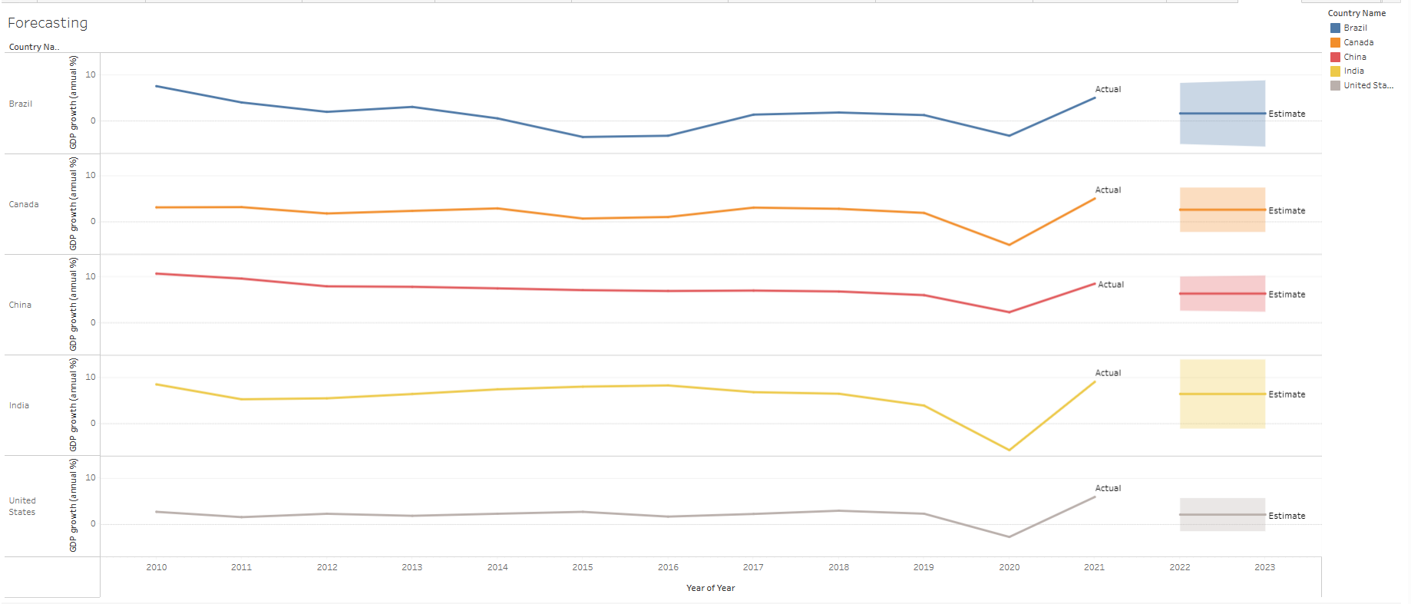
Notes:
Forecasting Results:
However, based on the overall analysis and forecasting visuals, it is evident that the Indian economy has been emerging as no. 1 . Also, China has shown a steady increase in its GDP growth (%) for the past 25 years followed by the USA, Canada and Brazil. So, I would highly recommend all investors to consider investing in India and China followed by USA, Canada and Brazil to get the best returns in their investments.

Slide 15
CHALLENGES
As it is real-time data, a huge effort was spent on data cleaning
Identifying the variables for modeling was a challenge for the given data set
Had to select appropriate models to identify the correlation between the factors with GDP growth
Data clean-up process was required every now and then to arrive at proper results
Had to typecast the data at certain places to have logical data insights in Tableau
Despite challenges, had a lot of learning curves throughout this project
Notes:
Since this is Real-time data – consumed huge effort on data cleaning and handling null values.
Had challenges in finding the appropriate models and identifying the correlation factors between variables.
Had to recursively perform data clean up
typecast the data to provide logical data insights through visuals.

Slide 16
FUTURE CONSIDERATIONS
Analyze specific indicators to provide insight by identifying which sector contributes the most to GDP growth
THANK YOU !!
Notes:
This would aid International investors in arriving at informed decisions for future investments. I would like to extend my sincere thanks to Lighthouse Labs for imparting the knowledge and for constant motivation and support. Thank you.

